Slide 1
1. 4 W E L C O M E T O D A T A S C I E N C E W O R L D
s
S r i r a m - I T E x p e r t
Y o u t u b e C h a n n e l : I n t e l l e c t S r i r a m

Slide 2
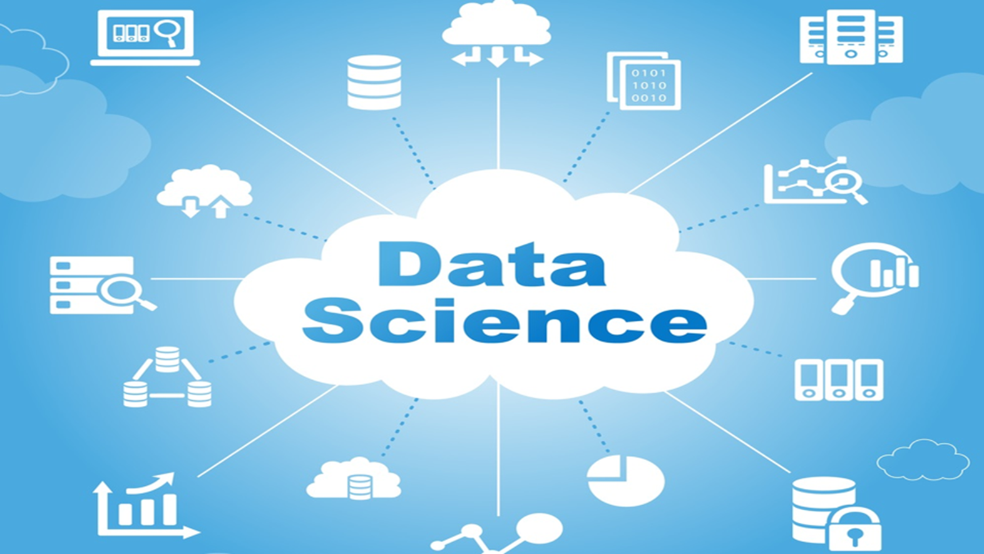

Slide 3
Part – I Welcome to Data Science World

Slide 4

Data & Facts
Welcome to Data Science World
Data is Everywhere…
But a scarcity of talent with the skills to make sense of it and create a value.
Up to 20% of analytics jobs are going filled or are being filled with difficulty(Source: Randstad)
While analytics and big data industry is recording an annual growth of almost 40%, the sector is witnessing an acute shortage of professionals. Specialized training is important to grow analytics skills.
Consider these Facts
Analytics industry is growing at over 16% CAGR in India (Source:Nasscomm)
In India, average salary for analysts and data scientists is 10.4 Lakhs per Annum (Source:TOI)
Experts estimate a shortfall of approximately 200,000 data analysts in India by 2019 (Source: jigsaw Academy)
Harvard Business Review (HBR) has called Data Scientist as the "Sexiest Job of 21st Century"

Slide 5
Understanding Business Analytics

Slide 6
Data Science Neighborhood Technologies
Welcome to Data Science World

Slide 7


Evolution of Decision Making
Welcome to Data Science World
Everyone makes decisions. Individuals face personal decisions such as choosing a college or graduate program, making product purchases, selecting a mortgage instrument, and investing for retirement.
Managers in business organizations make numerous decisions every day.
What products to make and how to price them?
Where to locate facilities?
How many people to hire?
Where to allocate advertising budgets?
Whether or not make a Capital Investment?
How to Schedule Production?

Slide 8
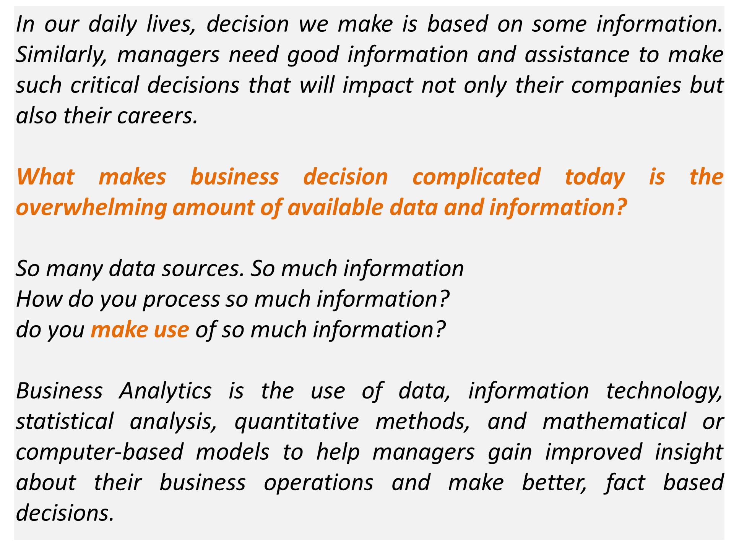

Business Analytics
Welcome to Data Science World

Slide 9
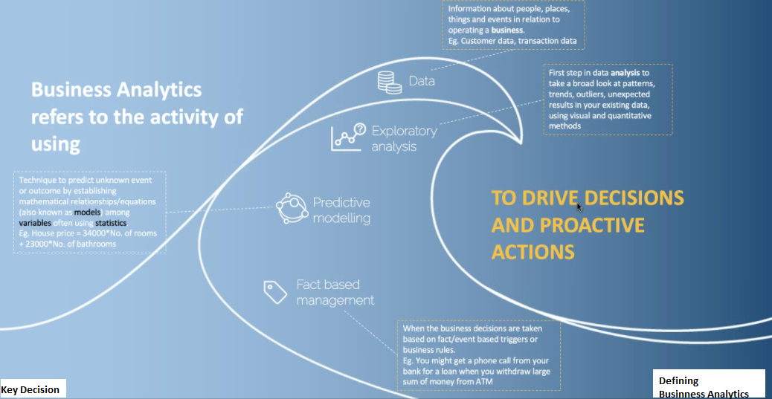
Defining Business Analytics
Welcome to Data Science World

Slide 10
Types of Analytics

Slide 11
Types of Analytics
Welcome to Data Science World

Slide 12
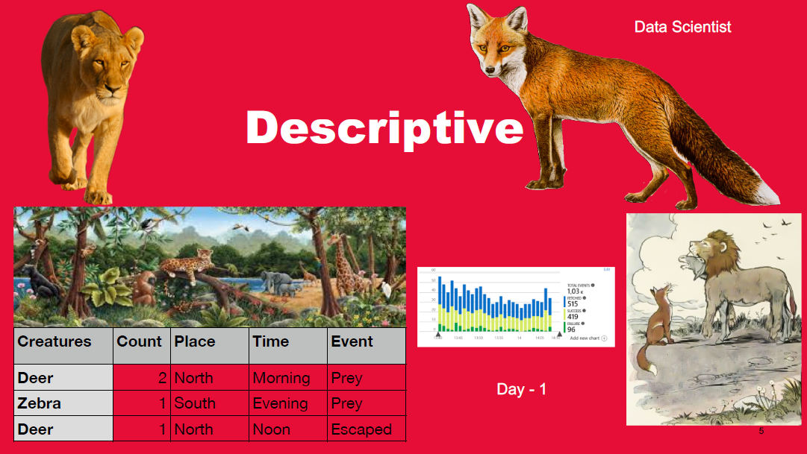
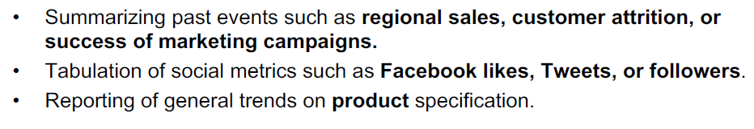
Descriptive Analytics
Welcome to Data Science World

Slide 13
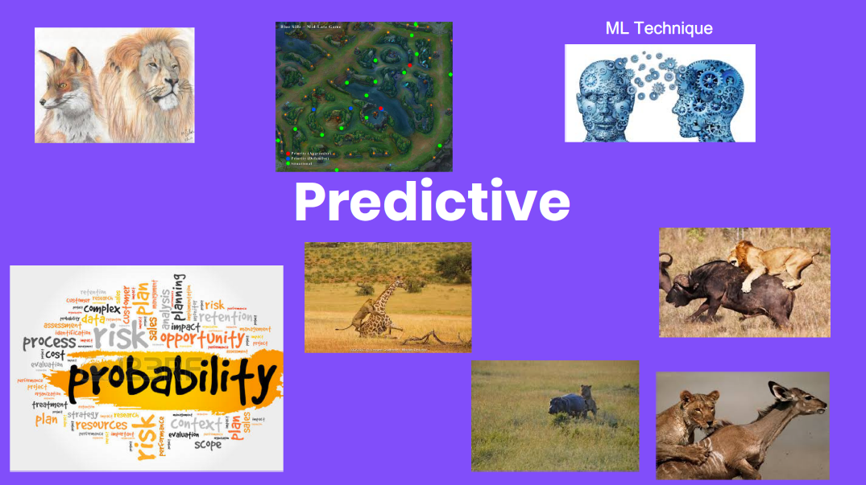
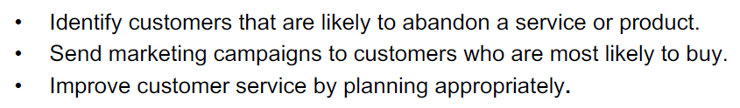
Predictive Analytics
Welcome to Data Science World

Slide 14
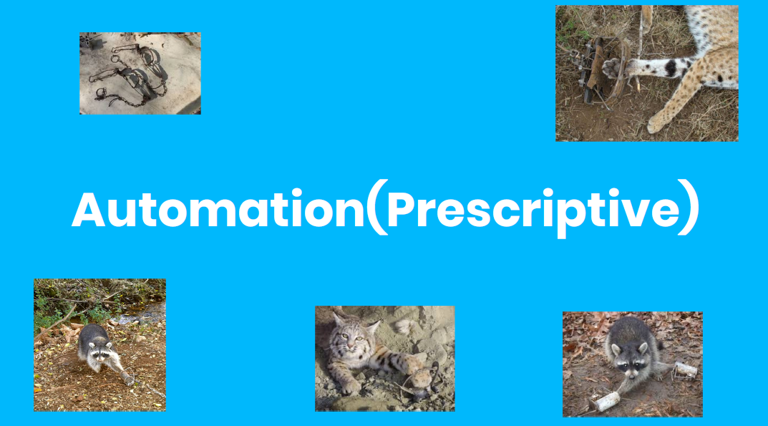
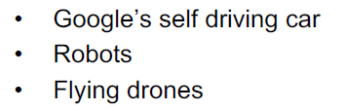
Prescriptive Analytics
Welcome to Data Science World

Slide 15
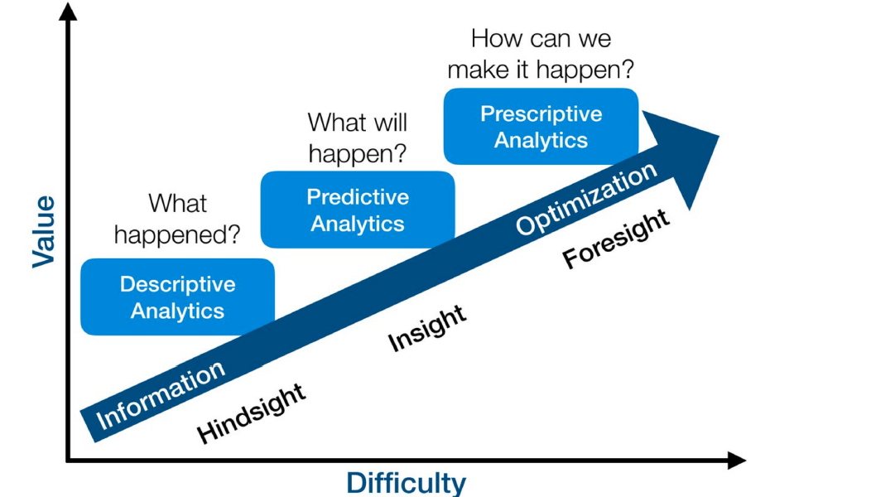
Analytics Fact
Welcome to Data Science World

Slide 16
Analytics Fact
Welcome to Data Science World

Slide 17
Understanding Data Science

Slide 18
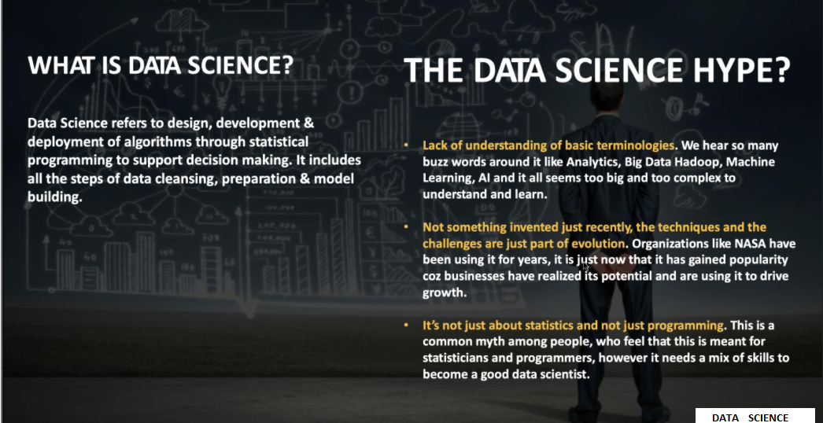
What is Data Science?
Welcome to Data Science World

Slide 19
Understanding Bigdata

Slide 20
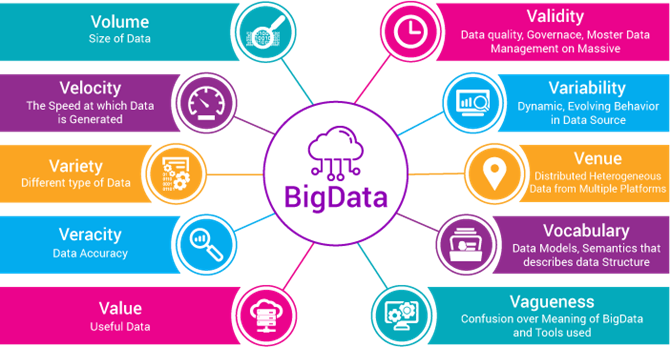
What is Big Data?
Welcome to Data Science World
Big data is a term for data sets that are so large or complex that traditional data processing application software is inadequate to deal with them.
Is it Just the size that defines my data as Big Data? No. Big Data can be described using 10 Vs

Slide 21
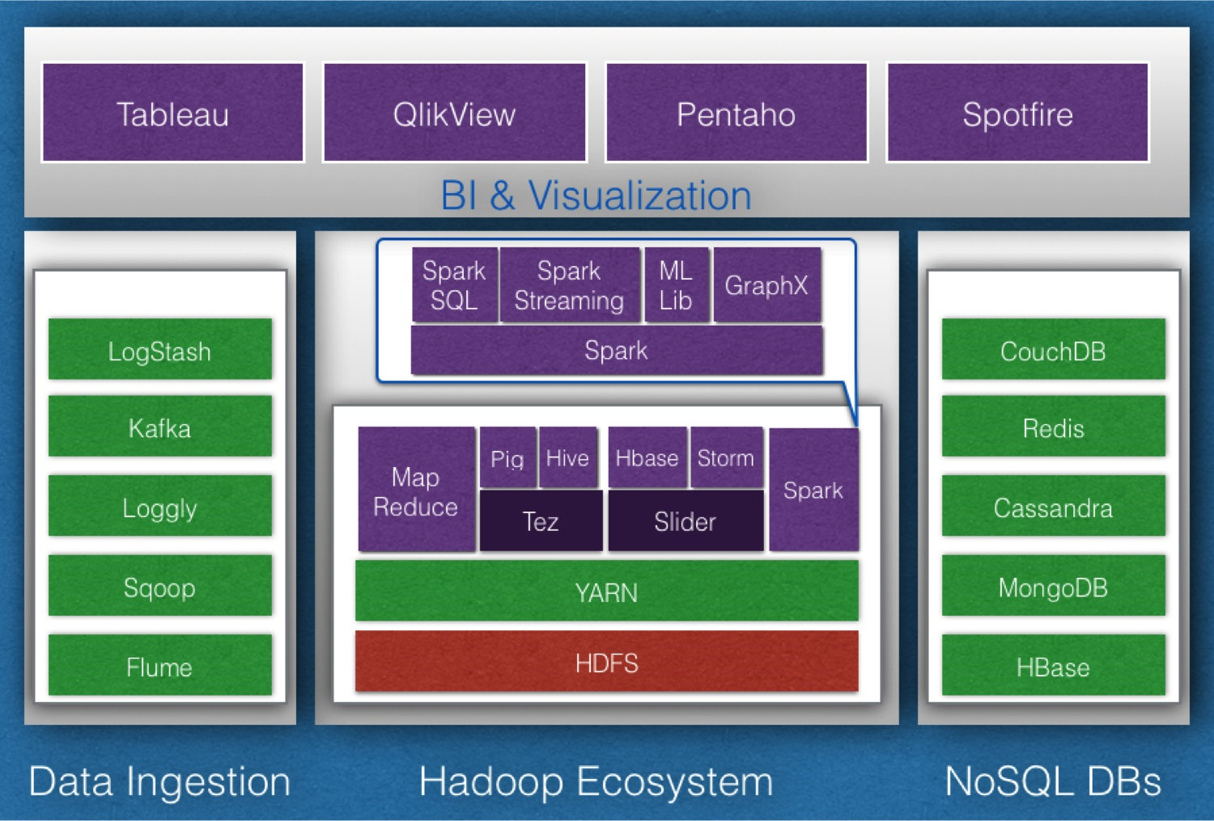
Technology associated with Big Data
Welcome to Data Science World
Data Ingestion: Sqoop, Flume, Kafka, Loggly, LogStash
Data Processing: Spark, Storm
Data Analysis: Pig, Hive
Data Discovery: Lucene, Solr, Elastic Search
Machine Learning: Mahout, H2O, Spark Mlib
Coordination: Zookeeper
NoSQL DBs: HBase, MongoDB, Cassandra, Couch DB, Redis
Visualization: Tableau, Qlikview, Pentaho, Spot fire

Slide 22
Decision Making Case Study in Data Science

Slide 23
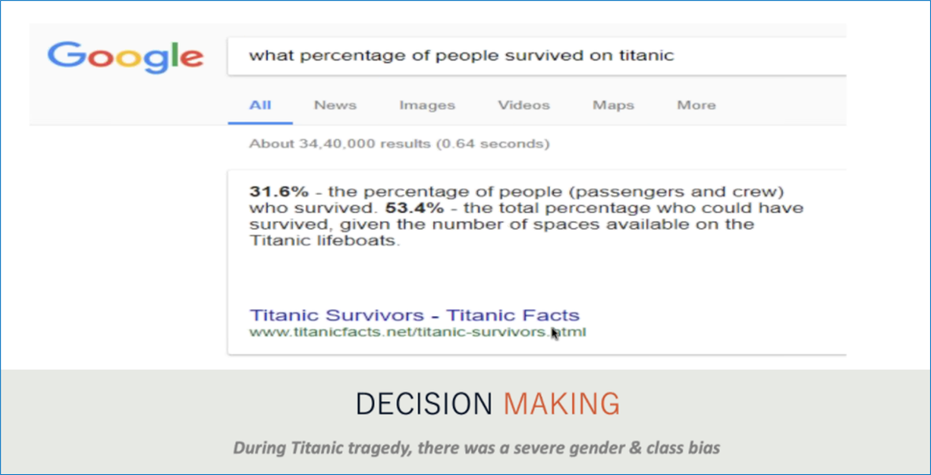
Decision Making Case Study 1 – Titanic Tragedy
Welcome to Data Science World

Slide 24
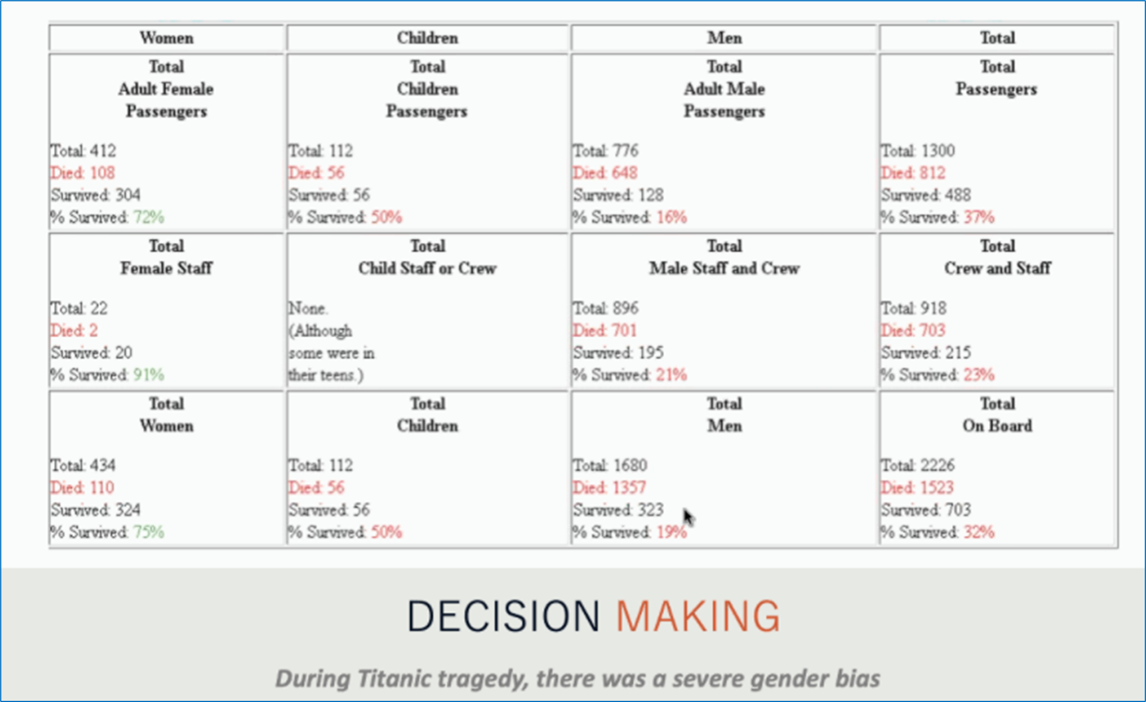
Decision Making Case Study 1 - Titanic Tragedy
Welcome to Data Science World

Slide 25
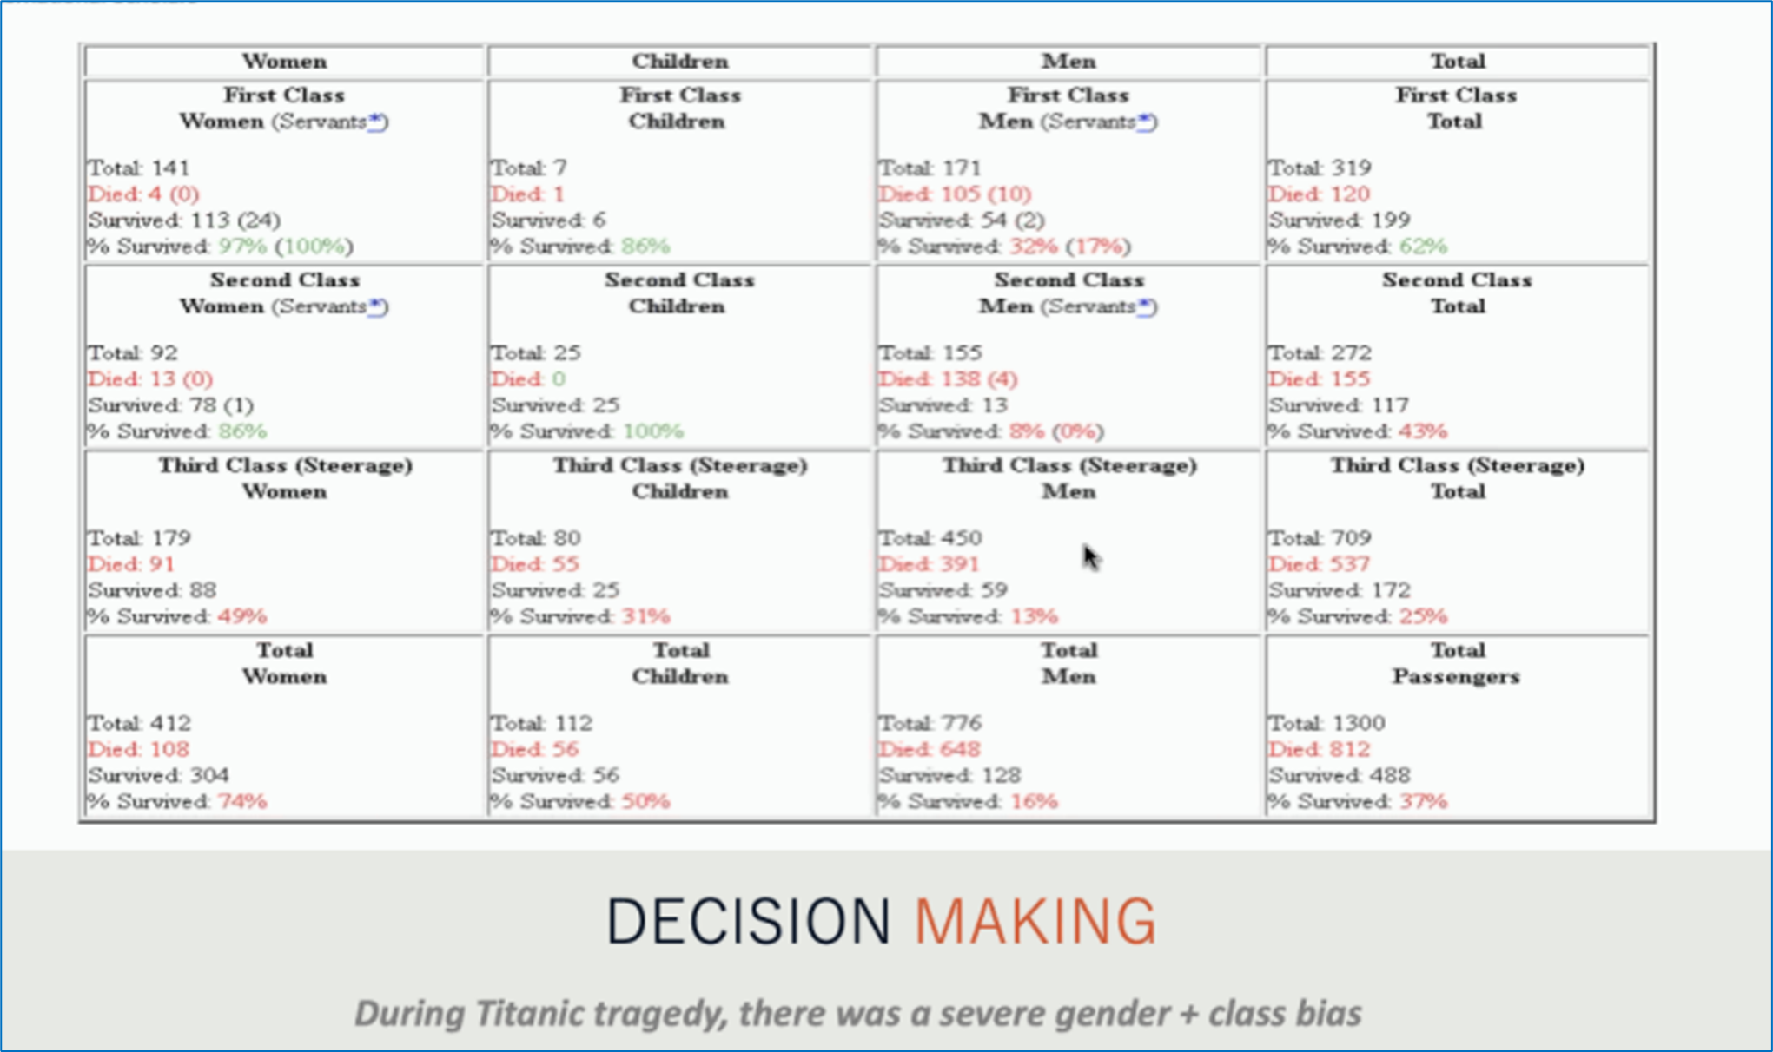
Decision Making Case Study 1 - Titanic Tragedy
Welcome to Data Science World

Slide 26

Decision Making Case Study 2 – Walmart Sales
Welcome to Data Science World
Highly targeted & personalized communication leads to a leading retailer know more about a lady than her own family.
Data Science is not just about analysis, it is also about story telling and creating value for the business. This is an art which is learned through mentors, practical exposure and structured training programs.

Slide 27
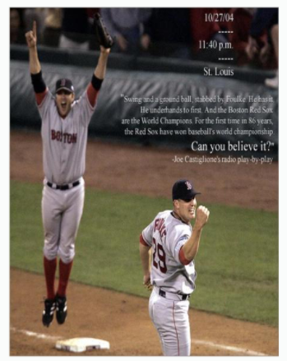
Decision Making Case Study 3 - World Cup Football
Welcome to Data Science World
The ability to extract knowledge from data presumably helped the Red Sox win the World Series in 2004 for the first time in 86 Years.
Wow. Great !! Decision Making helped lot.

Slide 28

Decision Making Case Study 4 – World Cup Cricket
Welcome to Data Science World
The ability to extract knowledge from data presumably helped the England win the World Cup Series in 2019 for the first time in 100 Years. Even though a national game of England they struggled lot.
Wow. Great !! Decision Making helped lot.

Slide 29
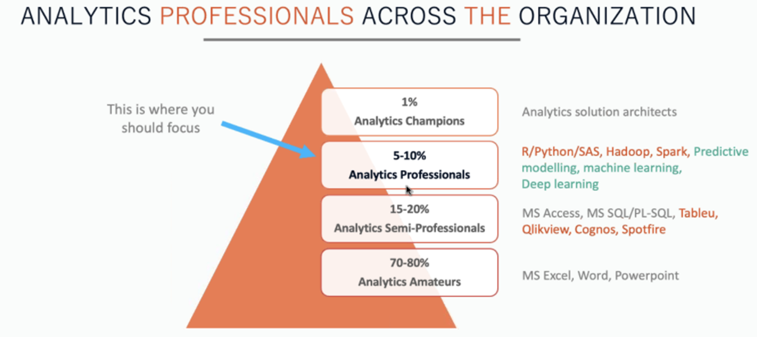
Analytics Professionals across the Organization
Welcome to Data Science World
a

Slide 30
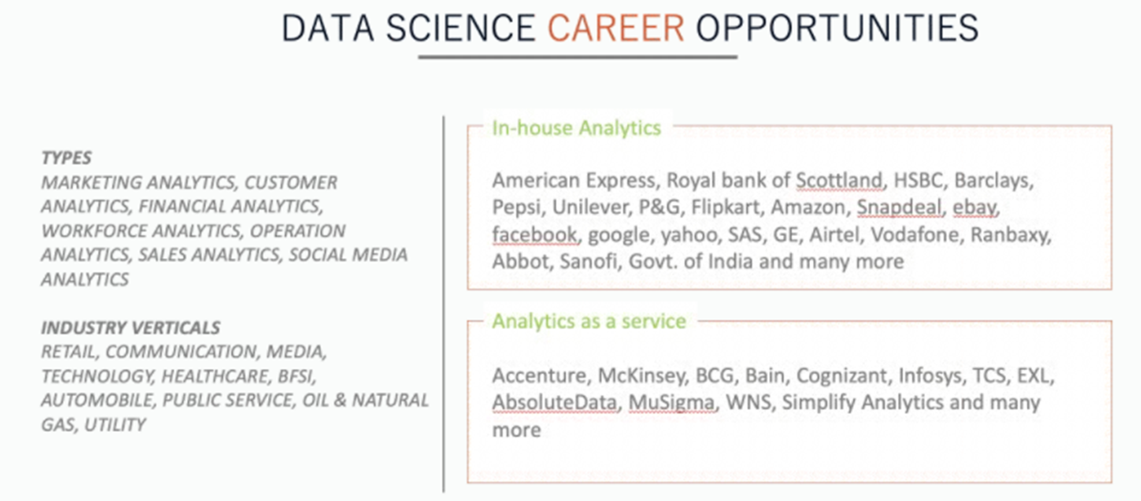
Data Science Career Opportunities
Welcome to Data Science World
a

Slide 31
Data Science World Summary
Welcome to Data Science World
We have learnt about the fundamentals of Data Science, Machine Learning and Big Data.
We have seen how powerful Data Science can be through some interesting case studies like Titanic, Walmart, Red Sox and England Cricket team.
We have also looked at the skills that organizations look for when they evaluate you as a potential Data Scientist which is not limited to technical expertise but also skills in story telling and business understanding.
We have also tried to help you recognize the skills you need to pivot into this fascinating world of data science which includes basic skills like MS Excel, Data Visualization, Data Analysis, Predictive Modelling, Statistics, etc.,
We have also looked at reason why people fail to transition to Data Science due to myths about professional backgrounds, hype about technical prowess, lack of business understandings etc.,

Slide 32


T h a n k Y o u !
I n t e l l e c t S r i r a m
Subscribed
LinkedIn : https://www.linkedin.com/in/sriram-balasubramanian-374566166/
GitHub : https://github.com/intellectsriram

